Slide 1
Online Quiz Management System
Malaika Mashaal
Reg No: BSSE/FA-22/082
Notes:
This template can be used as a starter file for presenting training materials in a group setting.
Sections
Right-click on a slide to add sections. Sections can help to organize your slides or facilitate collaboration between multiple authors.
Notes
Use the Notes section for delivery notes or to provide additional details for the audience. View these notes in Presentation View during your presentation.
Keep in mind the font size (important for accessibility, visibility, videotaping, and online production)
Coordinated colors
Pay particular attention to the graphs, charts, and text boxes.
Consider that attendees will print in black and white or grayscale. Run a test print to make sure your colors work when printed in pure black and white and grayscale.
Graphics, tables, and graphs
Keep it simple: If possible, use consistent, non-distracting styles and colors.
Label all graphs and tables.

Slide 2
Introduction
An Online Quiz Management System is a software platform or web application designed to create, administer, and manage quizzes in an online environment. This system is often used for educational purposes,
helps automate and streamline the process of creating, delivering, and evaluating quizzes. It is a versatile tool, essential for educators
Features
User management
Quiz management
Time flexibility
Feedback system
Categorized questions
Grading and scoring

Slide 3
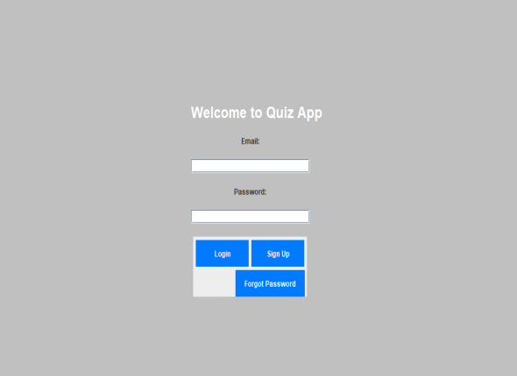
This is login page if person have already have an account they just add email and password if not then go to signup page by signup button

Slide 4
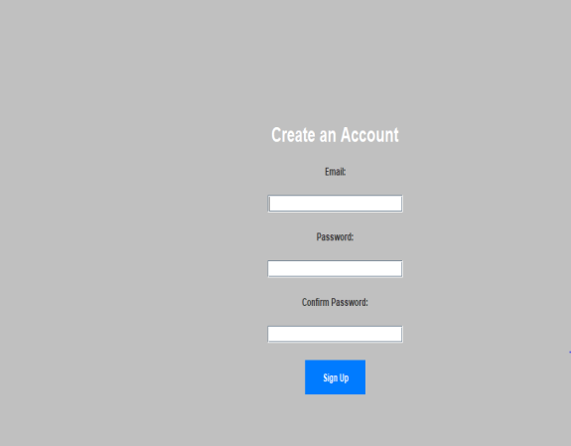
If person cannot have any account they can create an account by entering email and password and then by confirming password

Slide 5
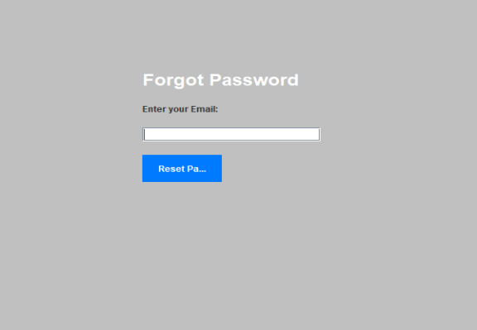
If person forgot the password then they enter their email and instruction sent to that email regarding changing of password

Slide 6
Design Patterns
Singleton pattern :The quiz system might include a Quiz Manager class to handle the entire quiz process, including selecting questions, storing answers, and calculating scores. Using a singleton pattern ensures that there is only one instance managing the quiz session to maintain consistency throughout the quiz.
Factory pattern: In a quiz system, questions can be of various types: multiple choice, true/false, short answer, etc. A factory can be used to instantiate different types of questions based on the question type, thus abstracting the question creation logic.

Slide 7
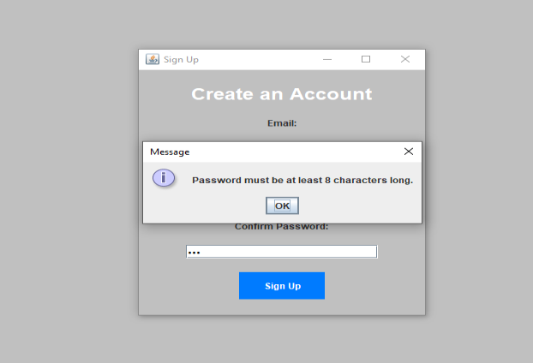
Input Validation
Input validation like password must be of at least 8 characters is added if password length will be shorter than 8 system did not allow to signup

Slide 8
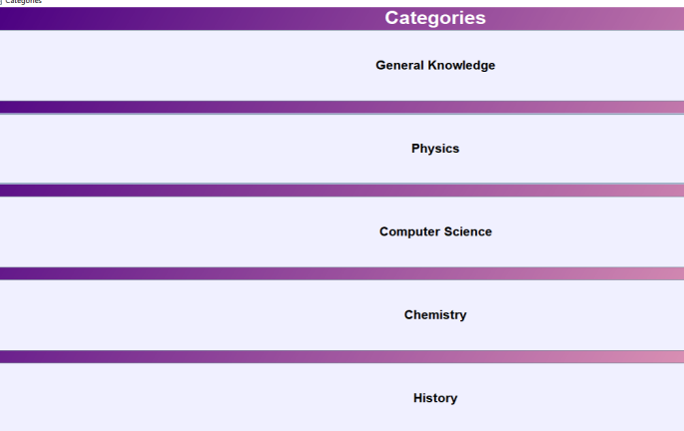
Subject Categories
A page where there are different subject categories so person can choose by their own choice

Slide 9
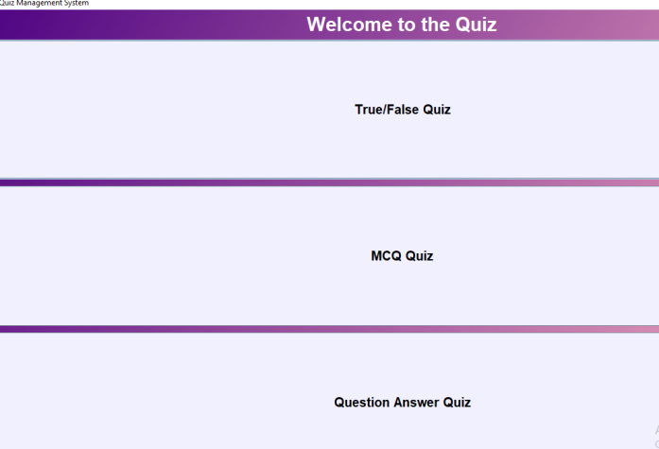
Categories
Quiz include different type of categories like true false, Mcqs and question answer

